Slide 1
Please Run: docker pull evl8/esd-github-actions-runner

Slide 2
CI/CD: GITHUB ACTIONS
ERIC VON LAGUNA, Stoyan Grozdev

Slide 3
AGENDA
Introduction to this workshop
Git Workflow Refresher
Introduction to GitHub Actions
Demo
Workflow Syntax and Structure
Comparison to Other CI/CD Tools
Practical Assignment
Quizz and wrap up

Slide 4
Think of the process of your development cycle!
How do you ensure that all developers run the tests?
How do you ensure code quality and consistency across your team?
Are there repetitive tasks in your github workflow that could be automated?
How do you ensure that configuration information is secured?

Slide 5

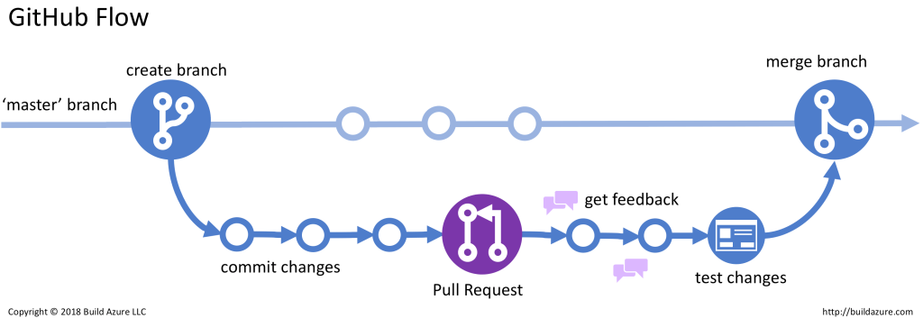
Github workflow refresher
Branch types: development, staging, production
Base commands: push, pull, merge
Example: https://build5nines.com/introduction-to-git-version-control-workflow/

Slide 6
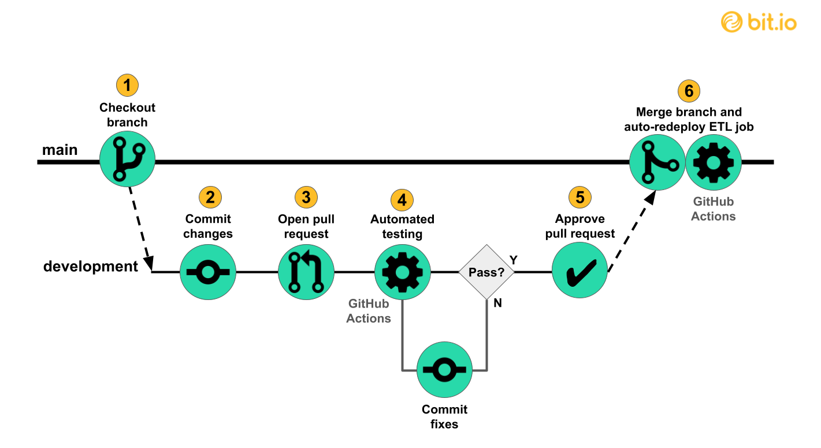
Github Actions introduction
Example: https://innerjoin.bit.io/making-a-simple-data-pipeline-part-4-ci-cd-with-github-actions-733251f211a6
What is Github Actions?
Where does GitHub Actions fit in the picture?
Why use Github Actions?
Enhancing Git Operations
Workflow automation

Slide 7
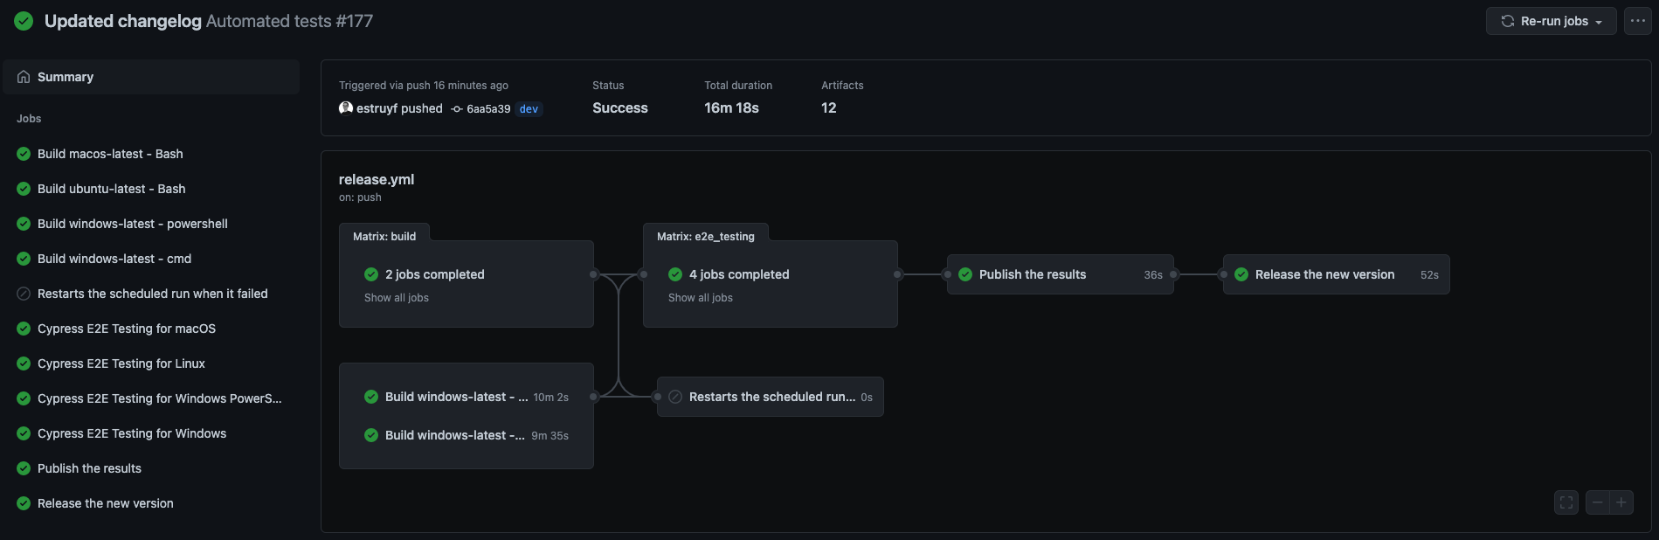
Example demo

Slide 8
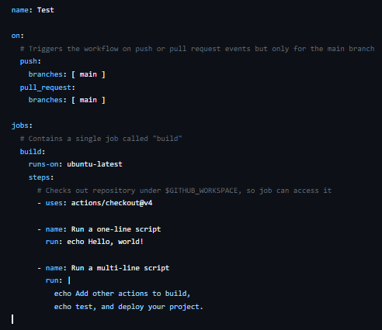
Understanding GitHub Actions Workflow Syntax
name - Assigns a name to your workflow. This name appears in the GitHub Actions tab.
Triggering Events (on): specifies the events that trigger a workflow, in this example it triggers on push and pull
Jobs Definition: unit of work that runs commands(build is the name of the job)
Runs-on: required attribute that you must have. It indicates the virtual enviroment where the job is running.
Steps: building blocks of a job in a GitHub Actions workflow. Think of them as individual tasks that a job needs to perform.
Uses: keyword in GitHub Actions that allows you to include and execute pre-built pieces of functionality—called actions—in your workflow. Think of it as a way to reuse existing tasks that someone else has already created, so you don’t have to reinvent the wheel every time.
Run: keyword in GitHub Actions is used to specify a command or a script that should be executed as part of a step within a job. Essentially, it allows you to write commands that you would normally run in a terminal, such as installing dependencies, building your code, or running tests.
Upload artifacts: The upload-artifact action in GitHub Actions is used to store files or directories (artifacts) from a workflow run. It allows you to upload build outputs, logs, or other files generated during a job. These artifacts can later be downloaded for debugging, sharing, or use in subsequent jobs.
- name: Upload artifacts
uses: actions/upload-artifact@v3
with:
name: build-artifact
path: .
- name: Download build artifact
uses: actions/download-artifact@v3
with:
name: build-artifact
Notes:
Name – mention that its optional and that if you don’t provide one it will default to the file name itself
Triggering events – mention that there are more triggers than these two which can be found in the github docs
Jobs definition: mention that there can be multiple jobs and that they can be chained

Slide 9
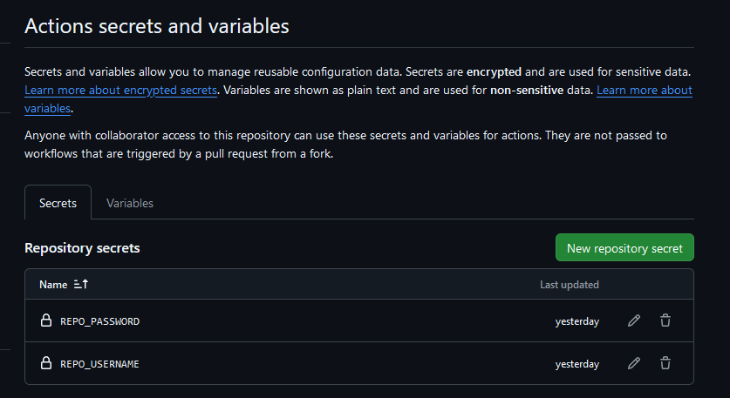

Secrets
Secrets are variables that are securely stored on Github
You define them in the repository settings and not in the code itself
You can access them later in a Github Actions workflow

Slide 10
Different Environments in a GitHub Actions Workflow
Development
Staging
Production
Good to run unit tests
Linting & code analysis
Runs integration and end-to- end tests
Deploys to staging server
Simulate User Scenarios
Smoke Testing
Deploy Final Code
Trigger Alerts for Issues
Send notification on release
Automated Rollbacks

Slide 11
Self-Hosted Runners vs. GitHub-Hosted Runners
GitHub-Hosted Runners
Self-Hosted Runners
Managed by GitHub.
Pre-Installed Tools.
Ease of Use.
Resource Limitations.
Scenarios.
Managed by You.
Custom Environment.
“Unlimited” Resources.
Cost Savings.
Scenarios.

Slide 12




GitHub Actions vs GitLab CI/CD
Feature | GitLab CI/CD | GitHub Actions
Deployment Strategies | Built-in support for canary, blue-green and rolling updates | Flexible but requires manual configuration for advanced strategies
Pipeline configuration | YAML file stored in .gitlab-ci.yml(includes CI Lint tool) | YAML files stored in .github/workflows(yml2dot third party)
Supported Runners | Linux(stable), macOS, Windows(beta) | Linux, macOS and Windows(all stable)
Marketplace/Plugins | No dedicated marketplace but supports custom scripts. | Extensive community-driven marketplace for reusable actions.
Integration | Seamless integration with GitLab’s ecosystem (security scanning, artifact management). | Integrated tightly with GitHub features like repositories, pull requests, and issue tracking.
Cost | Free tier with limited CI minutes; paid plans offer unlimited CI minutes. | Free for public repos; private repos billed based on usage (minutes and storage).
Security | Protected variables exposed only to specific branches/tags. | Secrets management tied to GitHub repository permissions.

Slide 13
Practical Exercises
Exercise 1: Repository Setup and Docker Runner
Exercise 2: Basic GitHub Actions Workflow
Exercise 3: SimpleTime Project with Unit Tests
Exercise 4: GitHub Pages Deployment
Exercise 5: Test Results and Comments
Exercise 6: Reusable Workflows (Optional)
https://github.com/evl-8/esd-github-actions-assignment

Slide 14
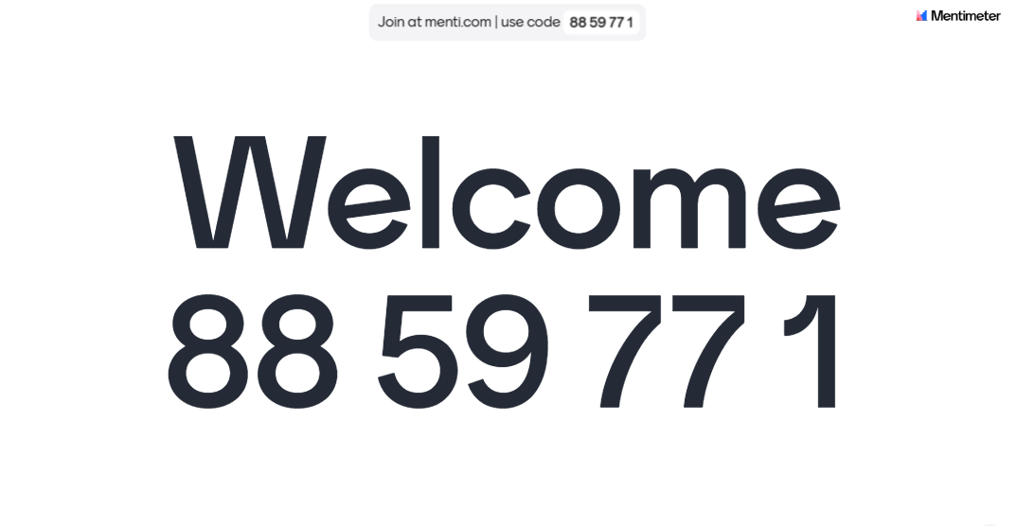
Q&A
Quizz, feedback

